Slide 1
Introduction to Testing

Slide 2
Contents
Objectives
Look at the main testing framework used in Java development
Contents
JUnit
How to set up and run
Annotations
NUnit for .NET later
Hands on lab
Author Unit Tests

Slide 3
Automatic
it checks its own results
Repeatable
it can be run again with the same results
Available
it accompanies the code being tested
Unit Tests must be…
Notes:
Tests are checked into source control, just like regular code – because they are as much a part of the project as the code

Slide 4
The benefits are really for the developer
You fix all the trivial problems as you go along
You know that they have not recurred
You document without effort, how you see other s/w interfacing with yours
You are able to refactor your code to make it more maintainable, faster... knowing that you haven’t broken anything.

Slide 5
Arrange
Set the starting conditions
Act
Invoke the method (or property) that is being tested
Assert
Decide if the test has passed or failed
Test Structure

Slide 6
Manual Tests
Write a test harness for the Class Under Test (CUT)
Main method creates instance of class, invokes methods and outputs to console the results
Drawbacks
Not structured; have to hand-craft each time
Not necessarily repeatable; may not work in 2 weeks time
Should be able to run at click of button and see whether they passed or failed
Will not run all the code
No standardised reporting
Requires visual inspection of console output
You may miss failures
Integration with other tools (e.g. your build, code coverage)
Notes:
You may see the acronyms
SUT: System Under Test
CUT: Class Under Test

Slide 7
Unit Testing
Unit tests
Test one unit in isolation
Also known as Component or Module testing
What is a unit?
Method
Class
Database query or transaction
Web Page
What are you testing?
You know the internals of the test – “White Box”
Notes:
Unit Testing is also known as Component or Module Testing. It is a form of “White Box” testing – in other words, where the author of the test has complete knowledge of the internals of the component being tested.
This contrasts with “Black Box” testing, in which only the interface of the component being tested is known and only that interface is tested.

Slide 8
“Family” of testing frameworks
JUnit for Java, NUnit and MSTest for .NET, Test::Unit for Perl
Simple framework with common design to organise and run tests
Setup, Test, Assertion, Tear Down
Essential for support of Extreme Programming & Test Driven Development
What is xUnit?

Slide 9
JUnit test method for Java

Slide 10
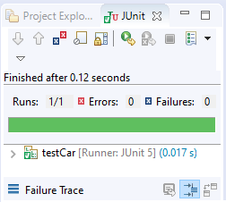
How to create a test?
Right click on the package name and select
New > Other > JUnit > JUnit test case
Select the CUT in the dialog and then write code:
Run the code
import static org.junit.jupiter.api.Assertions.*;
import org.junit.jupiter.api.Test;
class testCar {
@Test
void testCarAccelerate() {
Car car = new Car("Ford");
car.accelerate(10);
assertEquals(50, car.getSpeed());
}
}

Slide 11
JUnit @Before and @After annotations
class testCar {
Car car;
@BeforeEach
public void setUp() {
car = new Car("Ford");
}
@AfterEach
public void tearDown() {
car = null;
}
@Test
void testCarAccelerate() {
System.out.println("@test");
car.accelerate(10);
assertEquals(50, car.getSpeed());
}
}
Marks method to run before each @Test
Marks method to run after each @Test

Slide 12
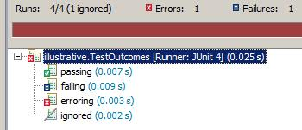
Statuses of a test
Passing: ultimately all our tests must pass
Failing: in TDD we always start with a test which fails
Erroring: test neither passes nor fails
Something has gone wrong, a run time error has occurred
Ignored: Using @Test @Ignore annotation

Slide 13
JUnit Assertions methods 1
Methods are overloaded, e.g.
Use String version: on failure message is displayed
Remember order: expected then actual – used in error reporting
Comparing doubles
assertEquals(Object expected, Object actual)
assertEquals(long expected, long actual)
assertEquals(String message, Object expected, Object actual)
assertEquals(String message, long expected, long actual)
assertEquals(double expected, double actual)
assertEquals(double expected, double actual, double delta)
Notes:
The methods most likely to be used all start assertEquals(…)
Remember the order of parameters – expected then actual. Tests that pass will still work if the parameters are the other way around. Tests that fail will still fail – however, the parameters are used in error reporting which could be confusing for other developers working on this code.
As well as overloaded assertEquals methods there are also assertArrayEquals methods.
Best practice would be to use the String version of an assert method so that the reason for failure will be stated if the assert fails.

Slide 14
JUnit Assertion methods 2
assertSame() – identity of reference
assertNotSame()
assertTrue() – check Boolean value
assertFalse()
assertNull() – check if an object is null
assertNotNull()
Fail method
fail()
fail(String message)
Notes:
assertSame()/assertNotSame() will determine if two objects refer to the same object.

Slide 15
JUnit @Test annotation
@Test marks method as a unit test
@Test(expected = Exception.class)
Will fail if the method does not throw the expected exception
@Test(expected = IndexOutOfBoundsException.class)
@Test(timeout = 200)
Will fail if the method takes longer than 200 milliseconds

Slide 16
Unit testing method for .NET

Slide 17
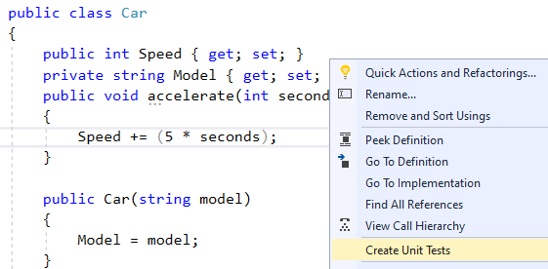
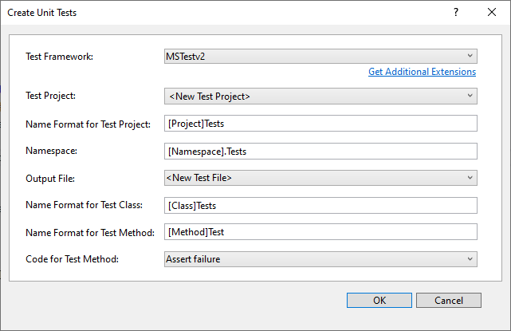
Create a MS-Test project
Right mouse click on a method and then create a unit test project

Slide 18
Write test code
[TestClass()]
public class CarTests {
Car car;
[TestInitialize]
public void SetUp() {
car = new Car("Ford");
}
[TestCleanup]
public void TearDown() {
car = null;
}
[TestMethod()]
public void accelerateTest() {
car.accelerate(10);
Assert.AreEqual(50, car.Speed);
}
}

Slide 19
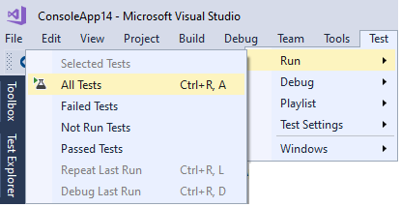
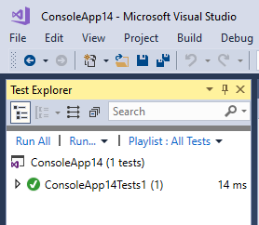
Run the tests

Slide 20
Testing Expected Exceptions with JUnit
3 approaches to testing for expected exceptions
Use the ExpectedException rule
Use the expected parameter with @Test
Use the try-catch block
@Rule
public ExpectedException exception = ExpectedException.none();
@Test
public void testConstrction() {
exception.expect(IllegalArgumentException.class);
exception.expectMessage(containsString("Invalid age"));
new Employee("Fred", -1);
}
@Test(expected = IllegalArgumentException.class)
public void testConstrction() {
new Employee("Fred", -1);
}
@Test
public void testExpectedException3() {
try {
new Employee("Fred", -1);
fail("Should raise exception");
} catch (IllegalArgumentException e) {
assertThat(e.getMessage(), containsString("Invalid age"));
}
}
Notes:
The first approach using ExpectedException is the most flexible one because you can test the exception message. The class allows in-test specification of expected exception types and messages. The static none() method returns a rule that expects no exception to be thrown.
The second approach using @Test is the most straight-forward. The third one using a try-catch block uses a familiar traditional approach, and it was used in older versions of JUnit.

Slide 21
Testing Expected Exceptions with MS-Test
The following test succeeds if null values entered as username
The Login() constructor throws exception
We test that exception is thrown
[TestMethod]
[ExpectedException(typeof(ArgumentException),
"username not specified")]
public void TestNullUsername()
{
LogonInfo login = new Login(null, "password123");
}

Slide 22
Unit Testing and Test Driven Development are the recommended approach to produce quality software
JUnit encourages the TDD mindset
Review

Slide 23
Hands On Lab
Writing tests for a security checker class for userID / password validation

Slide 24
THANK YOU
Hope you enjoyed this learning journey.

